Slide 1

Face Mask Detection with Alarm System
By: Venkatarami Reddy
Geet Nitin Pichika
Y.S.S.Siddharth

Slide 2
Contents:
Introduction
Motivation
Objective
Workflow Diagram
Explanation
Datasets
Implementation
Training
Testing & Result
Libraries and Development Tools
References and Citations

Slide 3
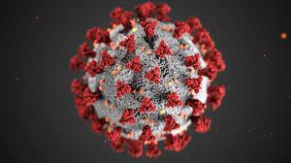
Introduction:
Corona virus has affected every single individual over the globe.
Every individual is taking fundamental measures to decrease its effect.
Our project is to prepare a data set which would detect whether a person on the camera is wearing a Face Mask or not and sends an alert to the security or the people who are monitoring it.

Slide 4
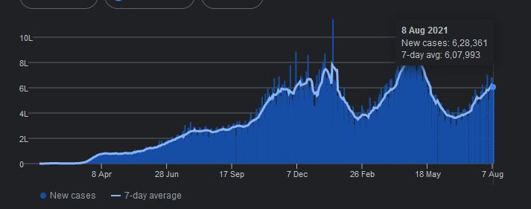
Motivation:
As the coronavirus is spreading rapidly, the World Health Organization has suggested to maintain social distance and to wear facemasks.
In support of the ongoing fight against this infectious disease, we are motivated to generate new insights, by providing information about the people who don’t wear facemasks, using deep learning techniques.

Slide 5
Objective:
A model is created using datasets with mask and without mask.
To identify people on camera without mask and sound an alarm to notify the authorities.

Slide 6
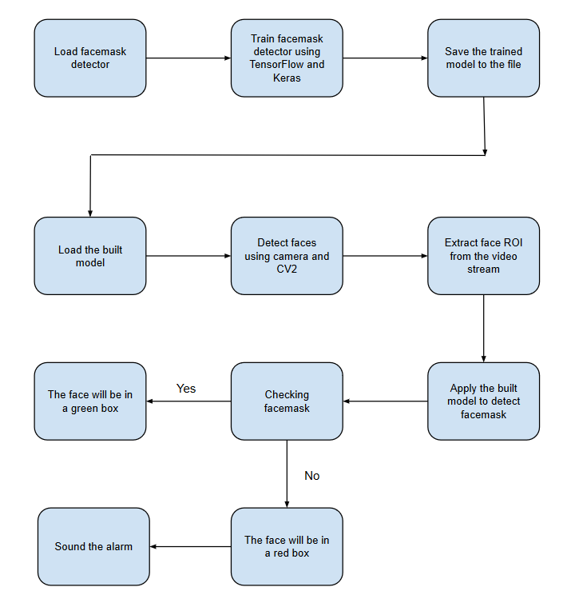
Workflow Diagram:

Slide 7
Explanation:
Phase 1: Train facemask detector and build a model:
- The datasets with and without mask are collected.
- Train the facemask classifier using Keras/Tensor Flow and
build a model using the datasets.
Phase 2 : Apply the model and Add alarm System:
- Load the built model.
- Cameras are switched on and the faces are detected using CV2.
- Extract Face ROI From the video.
- Applying the built model to detect facemask.
- Add the alarm system to the model using pygame.

Slide 8
Datasets:
Datasets are collected from Kaggle.
Two set of datasets composed of faces of various people from different parts of the world and of all age groups.
One set of dataset consists of faces of people with mask.
Other set of dataset consists of faces of people without mask.

Slide 9
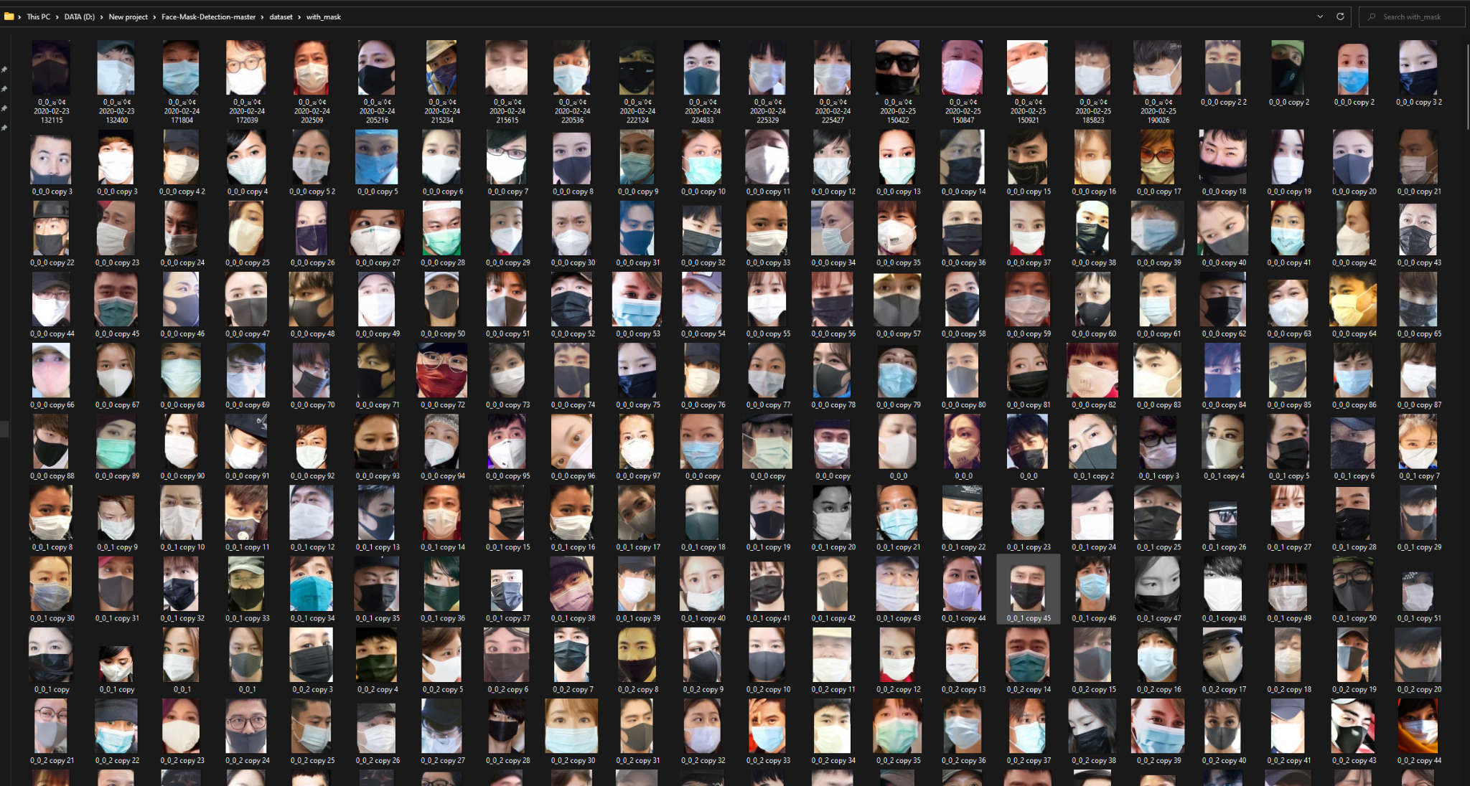
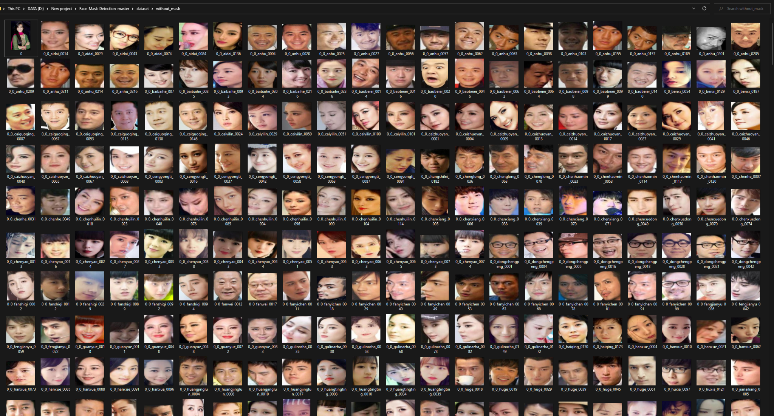
Dataset with and without facemask:

Slide 10
Pre-Processing:
In this section we will convert all the images in the categories with and without mask into arrays to create a deep-learning model.
Firstly with the help of keras.preprocessing.image we will load the images.
Next we will set the height and width of the images (in our case 224 x 224px)
Now with the help of img_to_array function we will convert the picture data into arrays.
Here we create 2 arrays namely, data[ ] and label[ ]
In data[ ] we copy data of all the images and in label [ ] we add according to the category, with mask or without mask.
With the help of binalizer() function from sklearn.model_selection we will convert the characters in label[ ] to binary values.
Now the data[ ] and label[ ] should be converted into NumPy arrays as deep learning models only work with arrays.
Next we will apply train_split_test function from sklearn.model_selection to train and test the images from data[ ] and label[ ]
We can change the percentage of images from the dataset to be used for training and testing.(In our case it is 80% and 20%)

Slide 11
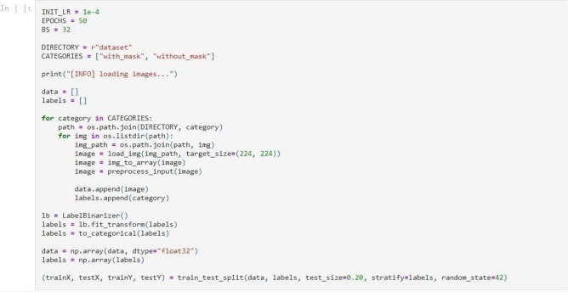
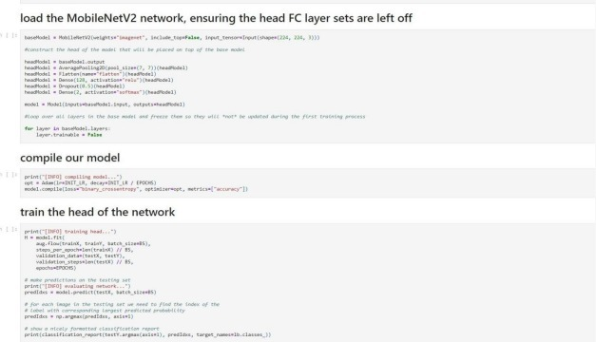
Training:

Slide 12
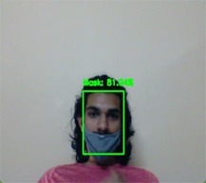
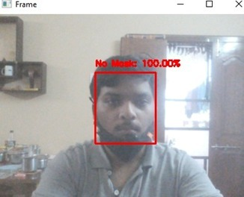
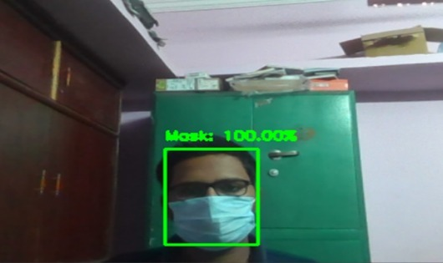
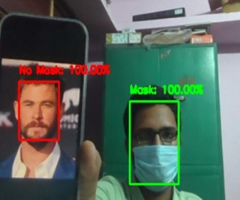
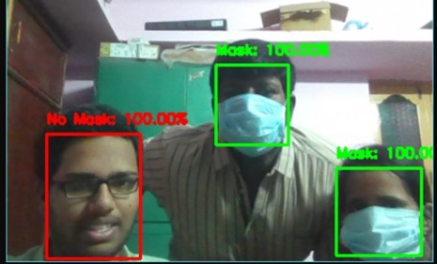
Testing & Result:

Slide 13





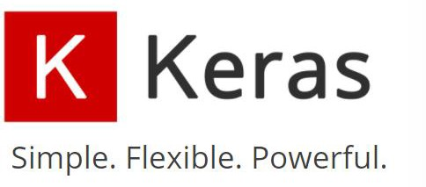
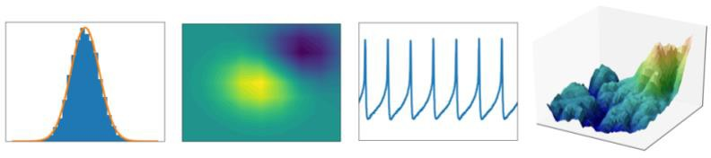

Libraries and Development Tools
Python
Jupyter Notebook
GitHub
TensorFlow
OpenCV
Keras
Matplotlib
Numpy

Slide 14
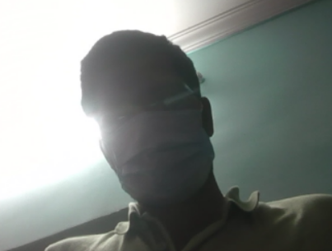
Limitations:
Lack of camera quality.
Camera should not be directly exposed to light.
Shutter speed should be more than 1/50 (Because in such case the blurring of the moving objects will occur)
Lack of vi deos in data sets to identify on video stream testing.
Excessive data will load in more time and more memory consumption in the system.
Recommended camera settings:
Quality: Highest possible (Minimum 480p is recommended)
Frame rate: 15 fps or more
Bitrate: 1400 – 4000kbps
Shutter Speed: More than 1/50

Slide 15
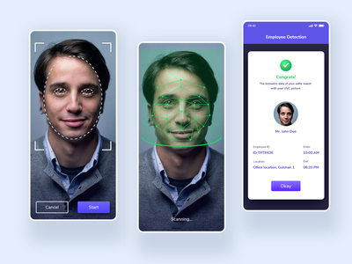
Future Goals:
Integrate with the voice system.
Creating an android and iOS application
Mask detection with very low end camera
Identity Detection
Adding the Email Sending feature to this
Application.

Slide 16
References and Citations
"Coronavirus Disease 2019 (COVID-19) Symptoms", Centers for Disease Control and Prevention, 2020, [online] Available: https://www.cdc.gov/coronavirus/2019-ncov/symptoms-testing/symptoms.html.
Jiri Prinosil, Ondrej Maly, "Detecting Faces With Face Masks", Telecommunications and Signal Processing (TSP) 2021 44th International Conference on, pp. 259-262, 2021.
Sushil Kumar Mishra, Nitish Kumar Ojha, "A Novel Approach for Face Mask Detection using Tensorflow for Covid-19", Inventive Research in Computing Applications (ICIRCA) 2021 Third International Conference on, pp. 1362-1366, 2021.
R. Gambler, "Facial Recognition Technology," United States Government Accountability Office, September 2020. [Online]. Available: https://www.gao.gov/assets/gao-20-568.pdf
S. V. M. a. N. V. Dionisio, "Real-Time Facemask Recognition with Alarm System using Deep Learning," IEEE Control and System Graduate Research Colloquium (ICSGRC), 2020 [Online]. Available: https://ieeexplore.ieee.org/stamp/stamp.jsp?arnumber=9232610.

Slide 17
THANK YOU
Any Queries ?
Want to Test our Model and Project ?..
Go To GitHub Link :
https://github.com/Chaganti-Reddy/Face-Mask-Detector

